Slide 1
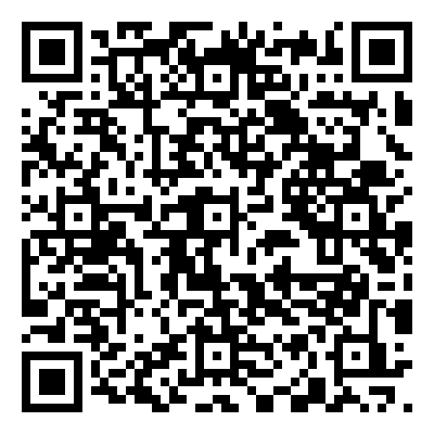
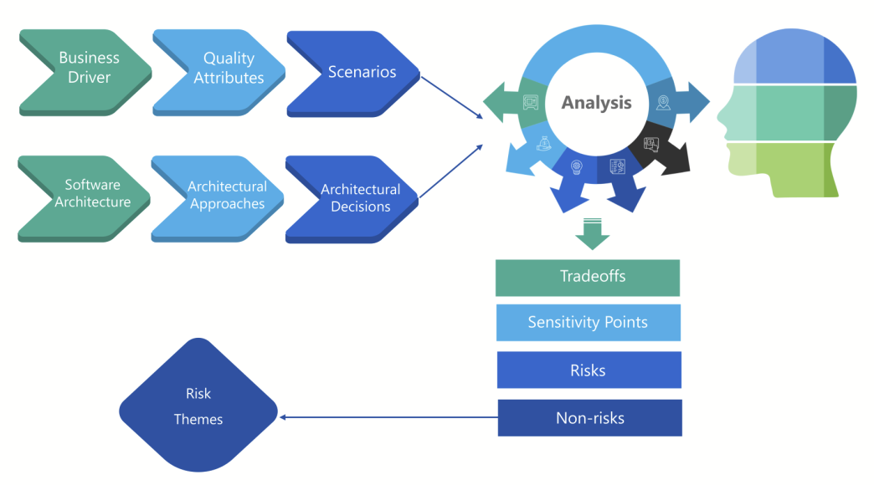
Software Architecture Evaluation Quiz
https://bit.ly/4iGkc6d

